Slide 1

Weather Forecast Mobile Application
James Vashiri
Computer and Information Science, MS
Fall 2025

Slide 2

Problem Statement
People need localized, reliable weather updates
Current apps are cluttered
not personalized

Slide 3
Solution / Concept
Android App
Web App
iOS App
Real-time weather API integration
Clean, easy-to-use interface
Cross-platform: Built with Flutter
Single Sign-on & data Synced across devices

Slide 4

WeatherApp Story Cards
Complete User Stories
James Vashiri
Ms. CIS Marquette University

Slide 5
Story: Logout
Task Description: End user session and return to login.
Acceptance Criteria:
  - Session terminated
  - Redirect to login
  - Weather data inaccessible
Initiating Event: User selects 'Logout'
Memory Context: Active login session exists
Observable Result: User logged out successfully
Related Stories: Login
Risk Factor: 1 (Low)
Functional Tests:
  - Logout ends session
  - Redirect to login screen
  - Access blocked after logout

Slide 6
Story: Login
Task Description: User enters credentials to access personalized weather services.
Acceptance Criteria:
  Valid credentials → login successful
  Invalid credentials → error message
  Session persists until logout
Initiating Event: User selects 'Login' from start screen
Memory Context: No active session; account exists in DB
Observable Result: Access granted or error shown
Related Stories: Forgot Password, Logout
Risk Factor: 2 (Medium)
Functional Tests:
  - Valid login → success
  - Invalid password → error
  - Unregistered email → error
  - Session persists until logout

Slide 7
Story: Forgot Password
Task Description: Allow user to reset password via email if forgotten.
Acceptance Criteria:
  Reset link sent to registered email
  Link valid for 24 hours
  User sets secure new password
Initiating Event: User selects 'Forgot Password' from login
Memory Context: User email exists in system
Observable Result: Password reset or error
Related Stories: Login
Risk Factor: 2 (Medium)
Functional Tests:
  - Valid email → reset link sent
  - Unregistered email → error
  - Expired link → error
  - New password updates successfully

Slide 8
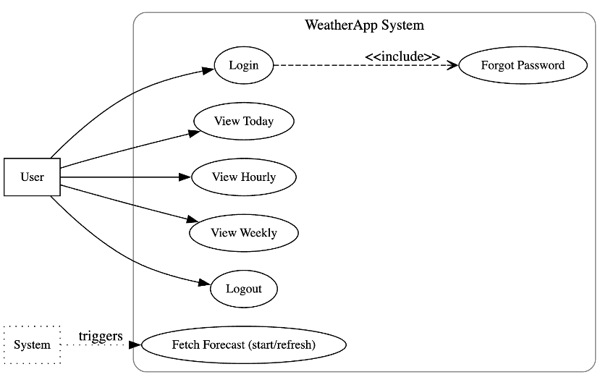
Use Case Diagram

Slide 9
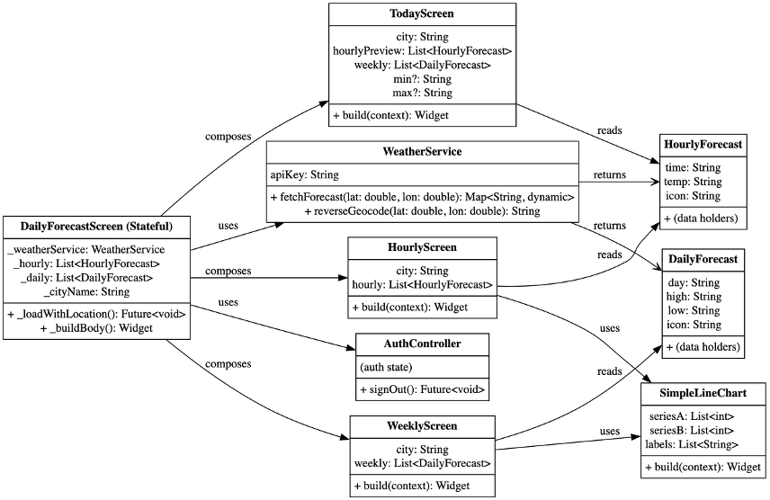
Class Diagrams

Slide 10

Q&A
Questions?

Slide 11
Story: View Today
Task Description: Display current day's forecast.
Acceptance Criteria:
  - Show temperature, condition, humidity
  - Show sunrise & sunset times
  - Update when refreshed
Initiating Event: User selects 'Today' from menu
Memory Context: Forecast data cached or available via API
Observable Result: Today's forecast displayed
Related Stories: View Hourly, View Weekly, Fetch Forecast
Risk Factor: 1 (Low)
Functional Tests:
  - API available → forecast shown
  - No network → cached data/fallback
  - Data updates after refresh

Slide 12
Story: View Hourly
Task Description: Display hourly forecast for today.
Acceptance Criteria:
  - Hourly temp, precipitation, condition
  - Cover next 12–24 hours
  - Update on refresh
Initiating Event: User selects 'Hourly' from menu
Memory Context: Hourly data available in API
Observable Result: Hourly forecast displayed
Related Stories: View Today, Fetch Forecast
Risk Factor: 2 (Medium)
Functional Tests:
  - 12–24 hour slots displayed
  - Correct icons per condition
  - Data updates after refresh

Slide 13
Story: Fetch Forecast
Task Description: System fetches updated weather data.
Acceptance Criteria:
  - Fetch at app launch
  - Fetch on refresh
  - Cache for offline
Initiating Event: App launch or refresh action
Memory Context: Cached data may exist
Observable Result: Latest forecast or fallback
Related Stories: View Today, View Hourly, View Weekly
Risk Factor: 3 (High) – dependent on API
Functional Tests:
  - API available → latest data shown
  - API unavailable → cached data shown
  - Offline → cached data or fallback

Slide 14
Story: View Weekly
Task Description: Display 7-day forecast.
Acceptance Criteria:
  - Min & max temps per day
  - Daily sunrise & sunset
  - Condition icons
  - Covers 7 days
Initiating Event: User selects 'Weekly' from menu
Memory Context: Weekly data in API
Observable Result: 7-day forecast displayed
Related Stories: View Today, Fetch Forecast
Risk Factor: 1 (Low)
Functional Tests:
  - Exactly 7 days displayed
  - Each entry has min/max, sunrise/sunset, condition
  - Data updates after refresh

